Slide 1
THE LIFE OF CHRIST
PART 40

Slide 2
Matthew 8, Mark 4, and Luke 8

Slide 3
Mark 4:35 On the same day, when evening had come, He said to them, "Let us cross over to the other side." ³⁶ Now when they had left the multitude, they took Him along in the boat as He was. And other little boats were also with Him.

Slide 4
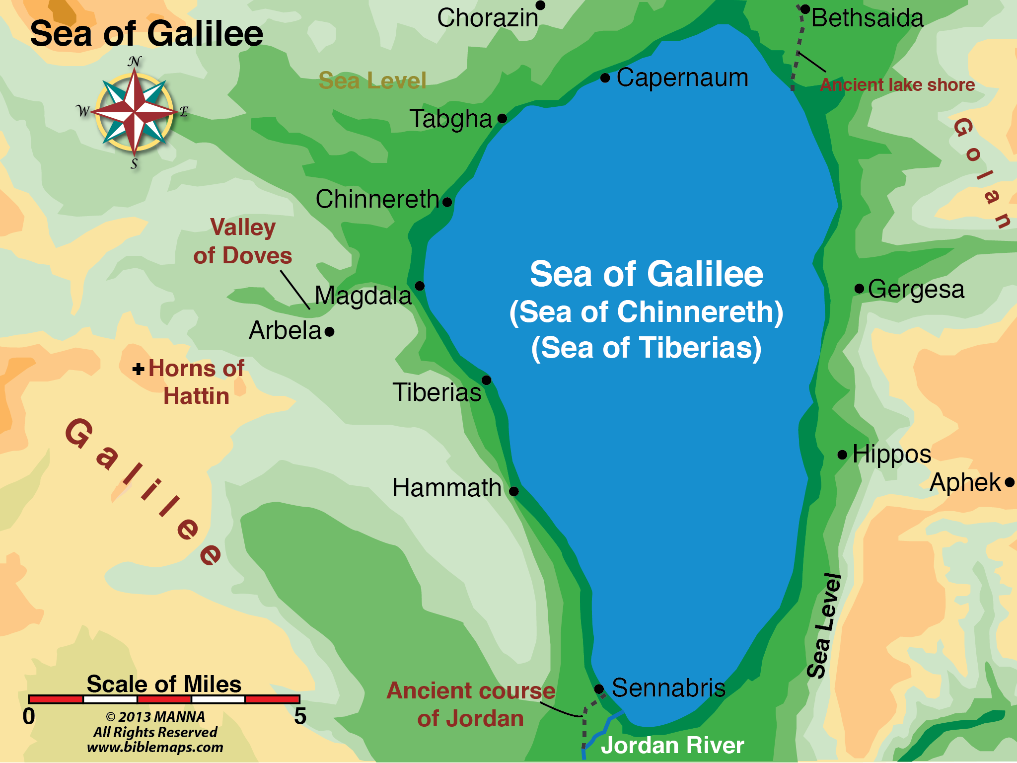

Slide 5
Christ here proposed a crossing to the eastern side of Lake Galilee. This beautiful lake was surrounded by at least a dozen towns in the time of Christ and was the most densely populated area of Palestine. It is thirteen miles long, six miles wide, pear-shaped; and the surface lies 700 feet below sea level. Steep mountains rise along both the western and eastern shores. It is fed by the Jordan river which enters at the north end and exits at the south where it resumes its course to the Dead Sea. The water is fresh and sweet, abounds with fish, and is edged with sparkling pebbly beaches. Due to its depression below sea level and the bordering mountains, it is subject to very severe and sudden storms, such as the one related here.

Slide 6
Mark 4:37 And a great windstorm arose, and the waves beat into the boat, so that it was already filling. ³⁸ But He was in the stern, asleep on a pillow. And they awoke Him and said to Him, "Teacher, do You not care that we are perishing?" ³⁹ Then He arose and rebuked the wind, and said to the sea, "Peace, be still!" And the wind ceased and there was a great calm.

Slide 7
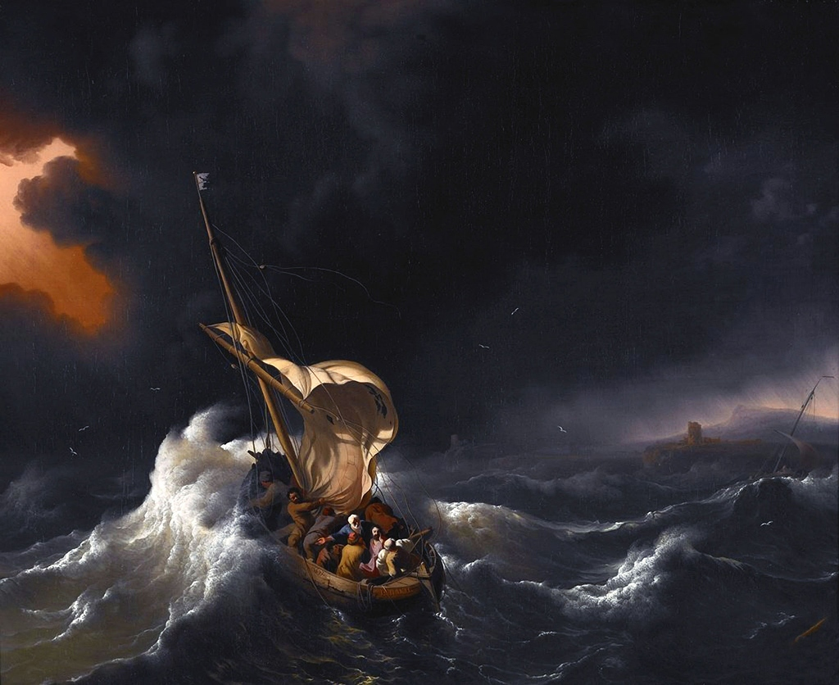

Slide 8
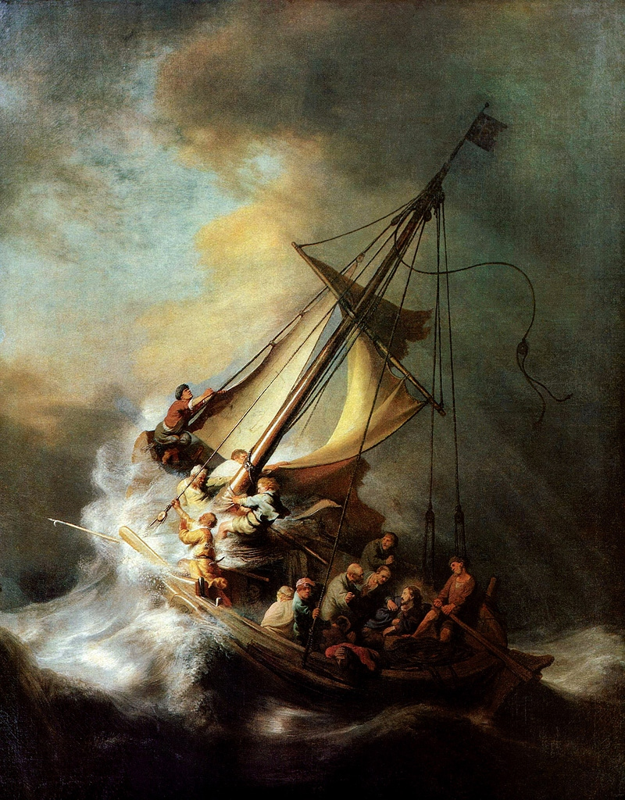

Slide 9
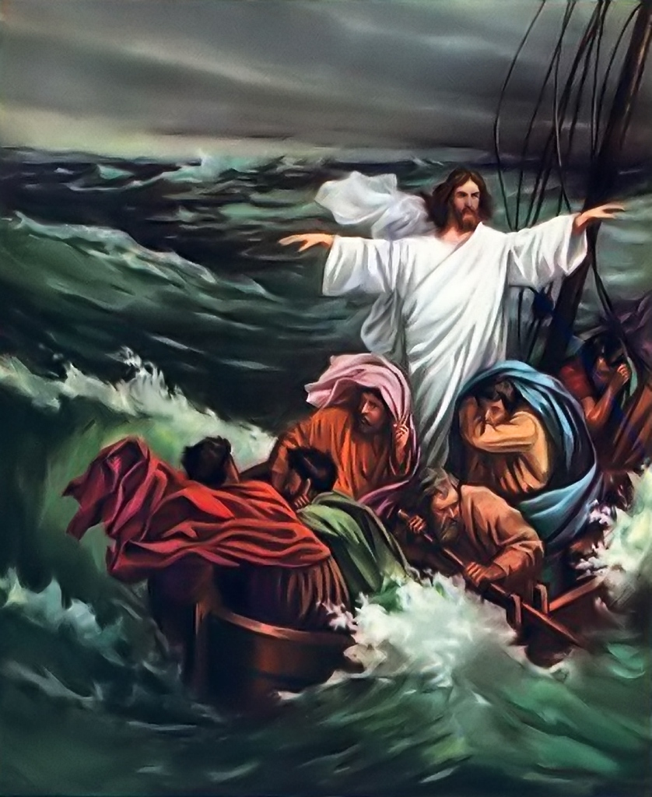

Slide 10
Mark 4:40 But He said to them, "Why are you so fearful? How is it that you have no faith?" ⁴¹ And they feared exceedingly, and said to one another, "Who can this be, that even the wind and the sea obey Him!"

Slide 11
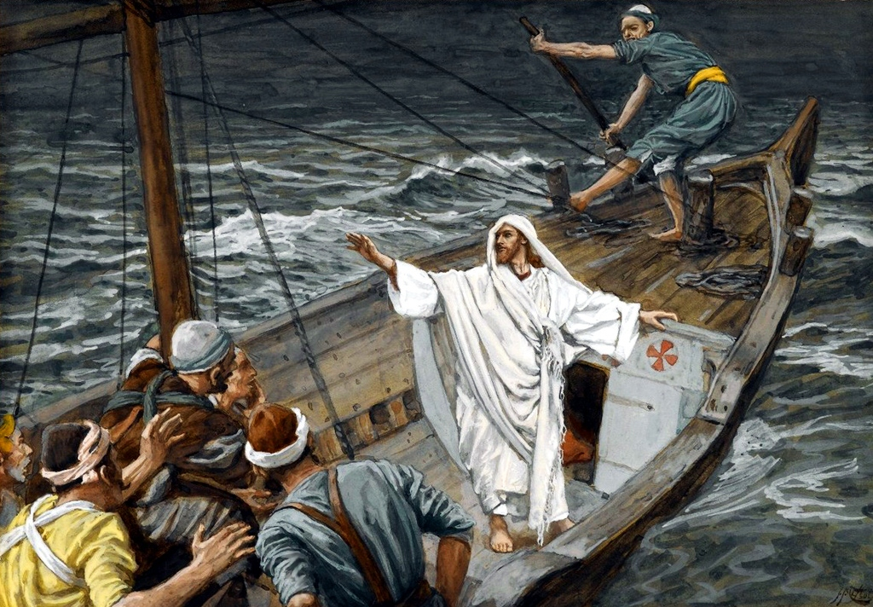

Slide 12
Romans 8:28 And we know that all things work together for good to those who love God, to those who are the called according to His purpose.

Slide 13
2 Timothy 4:6 For I am already being poured out as a drink offering, and the time of my departure is at hand. ⁷ I have fought the good fight, I have finished the race, I have kept the faith. ⁸ Finally, there is laid up for me the crown of righteousness, which the Lord, the righteous Judge, will give to me on that Day, and not to me only but also to all who have loved His appearing.

Slide 14
Mark 5:1 Then they came to the other side of the sea, to the country of the Gadarenes. ² And when He had come out of the boat, immediately there met Him out of the tombs a man with an unclean spirit, ³ who had his dwelling among the tombs; and no one could bind him, not even with chains, ⁴ because he had often been bound with shackles and chains. And the chains had been pulled apart by him, and the shackles broken in pieces; neither could anyone tame him. ⁵ And always, night and day, he was in the mountains and in the tombs, crying out and cutting himself with stones.

Slide 15
Mark 5:6 When he saw Jesus from afar, he ran and worshiped Him. ⁷ And he cried out with a loud voice and said, "What have I to do with You, Jesus, Son of the Most High God? I implore You by God that You do not torment me." ⁸ For He said to him, "Come out of the man, unclean spirit!" ⁹ Then He asked him, "What is your name?" And he answered, saying, "My name is Legion; for we are many." ¹⁰ Also he begged Him earnestly that He would not send them out of the country.

Slide 16
Matthew 8:29 Have You come here to torment us before the time?"

Slide 17
Mark 5:11 Now a large herd of swine was feeding there near the mountains. ¹² So all the demons begged Him, saying, "Send us to the swine, that we may enter them." ¹³ And at once Jesus gave them permission. Then the unclean spirits went out and entered the swine (there were about two thousand); and the herd ran violently down the steep place into the sea, and drowned in the sea.

Slide 18
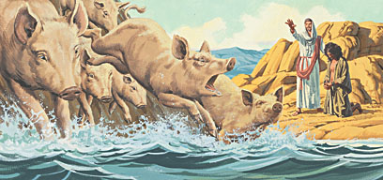

Slide 19
Mark 5:14 So those who fed the swine fled, and they told it in the city and in the country. And they went out to see what it was that had happened. ¹⁵ Then they came to Jesus, and saw the one who had been demon-possessed and had the legion, sitting and clothed and in his right mind. And they were afraid. ¹⁶ And those who saw it told them how it happened to him who had been demon-possessed, and about the swine. ¹⁷ Then they began to plead with Him to depart from their region.

Slide 20
Mark 5:18 And when He got into the boat, he who had been demon-possessed begged Him that he might be with Him. ¹⁹ However, Jesus did not permit him, but said to him, "Go home to your friends, and tell them what great things the Lord has done for you, and how He has had compassion on you."

Slide 21
Matthew 9:18-26; Mark 5:21-43; Luke 8:40-56

Slide 22
Mark 5:21 Now when Jesus had crossed over again by boat to the other side, a great multitude gathered to Him; and He was by the sea. ²² And behold, one of the rulers of the synagogue came, Jairus by name. And when he saw Him, he fell at His feet ²³ and begged Him earnestly, saying, "My little daughter lies at the point of death. Come and lay Your hands on her, that she may be healed, and she will live." ²⁴ So Jesus went with him, and a great multitude followed Him and thronged Him.

Slide 23
Mark 5:25 Now a certain woman had a flow of blood for twelve years, ²⁶ and had suffered many things from many physicians. She had spent all that she had and was no better, but rather grew worse. ²⁷ When she heard about Jesus, she came behind Him in the crowd and touched His garment. ²⁸ For she said, "If only I may touch His clothes, I shall be made well." ²⁹ Immediately the fountain of her blood was dried up, and she felt in her body that she was healed of the affliction.

Slide 24
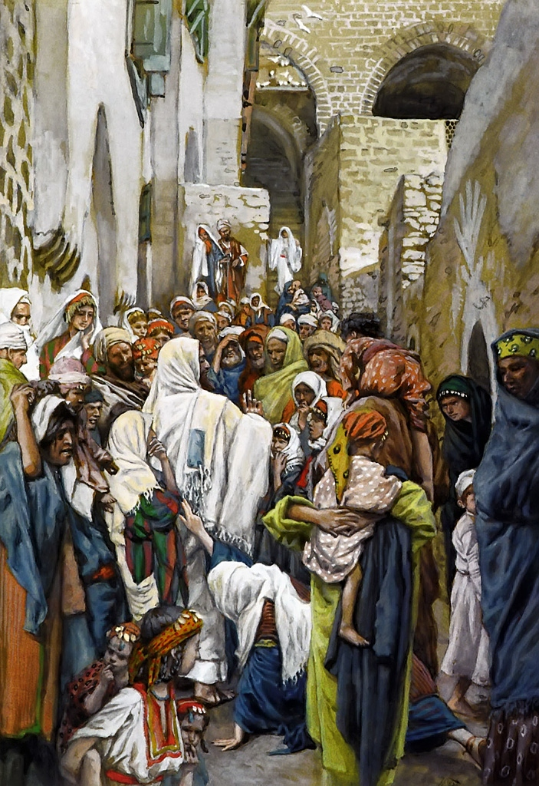

Slide 25
Mark 5:30 And Jesus, immediately knowing in Himself that power had gone out of Him, turned around in the crowd and said, "Who touched My clothes?" ³¹ But His disciples said to Him, "You see the multitude thronging You, and You say, 'Who touched Me?' " ³² And He looked around to see her who had done this thing. ³³ But the woman, fearing and trembling, knowing what had happened to her, came and fell down before Him and told Him the whole truth. ³⁴ And He said to her, "Daughter, your faith has made you well. Go in peace, and be healed of your affliction."

Slide 26
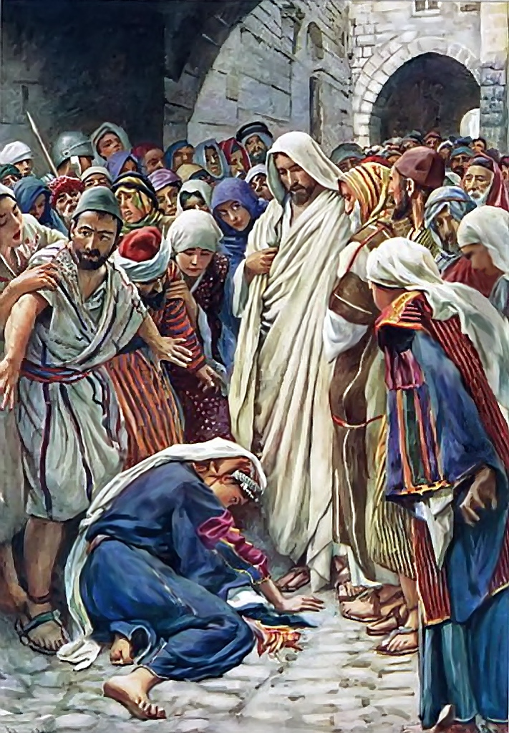

Slide 27
Mark 5:35 While He was still speaking, some came from the ruler of the synagogue's house who said, "Your daughter is dead. Why trouble the Teacher any further?" ³⁶ As soon as Jesus heard the word that was spoken, He said to the ruler of the synagogue, "Do not be afraid; only believe." ³⁷ And He permitted no one to follow Him except Peter, James, and John the brother of James. ³⁸ Then He came to the house of the ruler of the synagogue, and saw a tumult and those who wept and wailed loudly. ³⁹ When He came in, He said to them, "Why make this commotion and weep? The child is not dead, but sleeping." ⁴⁰ And they ridiculed Him. But when He had put them all outside, He took the father and the mother of the child, and those who were with Him, and entered where the child was lying.

Slide 28
Mark 5:4 Then He took the child by the hand, and said to her, "Talitha, cumi," which is translated, "Little girl, I say to you, arise." ⁴² Immediately the girl arose and walked, for she was twelve years of age. And they were overcome with great amazement. ⁴³ But He commanded them strictly that no one should know it, and said that something should be given her to eat.

Slide 29
